Slide 1
CROWDFUNDING Kickstarter
Data Analytics Project – 277
Group – 2
Mentor – Arif Mohammad

Slide 2
Table of contents
01
04
02
05
03
06
Introduction
Dashboards
Problem Statement
Insights & Suggestions
Data Model & Challenges
Conclusion

Slide 3
01
Introduction

Slide 4

Whats is crowdfundig?
To put it in simple words, crowdfunding is funding a project (idea/startups) by lot of people (the crowd), each contribute a small amount of money to reach the goal.
The investors are called as Backers or Supporters.
Four Types (Returns) :
Reward-based crowdfunding.
Equity-based crowdfunding.
Debt-based crowdfunding.
Donation-based crowdfunding.

Slide 5

Kickstarter
Kickstarter is primarily a reward-based online crowdfunding platform. Popular for funding creative projects.
On Kickstarter, creators showcase their projects, set a funding goal, and offer various non-financial rewards or incentives to backers who support the project financially, such as early access to the product, special editions, or other creative perks related to the project.
Generally the projects are supported by friends, fans, interested community members, Industry Enthusiasts.
Till the Day Kickstarter funded 249K Projects and generated $7.7B in economic impact.

Slide 6
02
Problem Statement

Slide 7
What we want to achieve?
Aim company
Our focus
Kickstarter platform majorly focus on creative projects and aims to make funding accessible to everyone. The company's main objective is to bring creative ideas to reality.
Focus should be to increase percentage of successful projects.
For this Analysis we used different modules; Excel, Power-Bi, Tableau and MySQL.

Slide 8
03
Data Model & Challenges

Slide 9
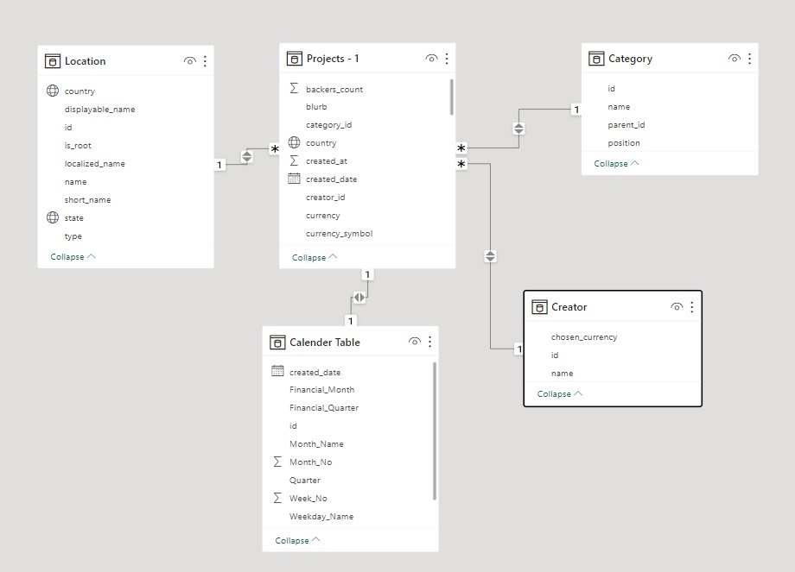
Data Overview
Projects Table:
Includes general data about number of backers, goal amount, pledged amount, created date, deadlines and successful dates. (2009-2019)
Category Table:
169 different categories
Creator Table:
312K different creators with total 366K projects.
Location Table:
Majority belong to US.
Calendar Table:
Created date

Slide 10
04
Dashboards

Slide 11

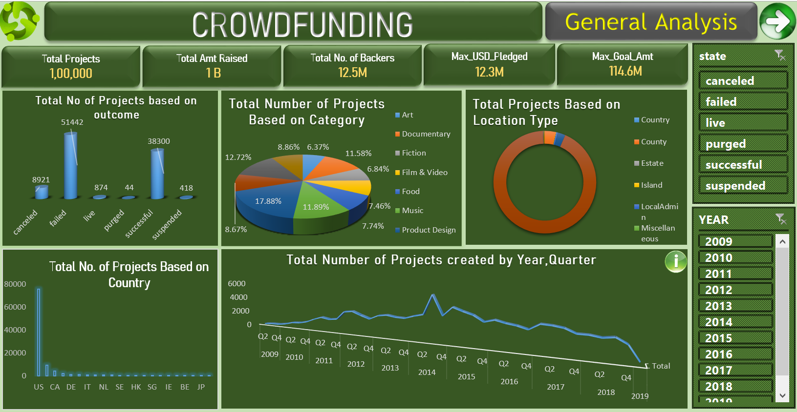
EXCEL DASHBOARD

Slide 12

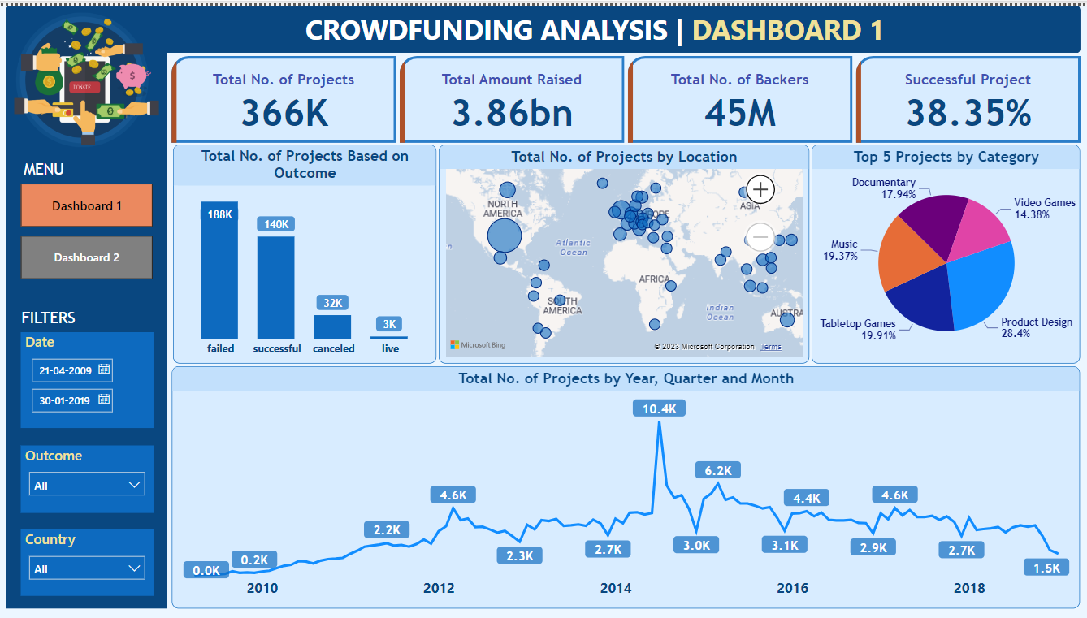
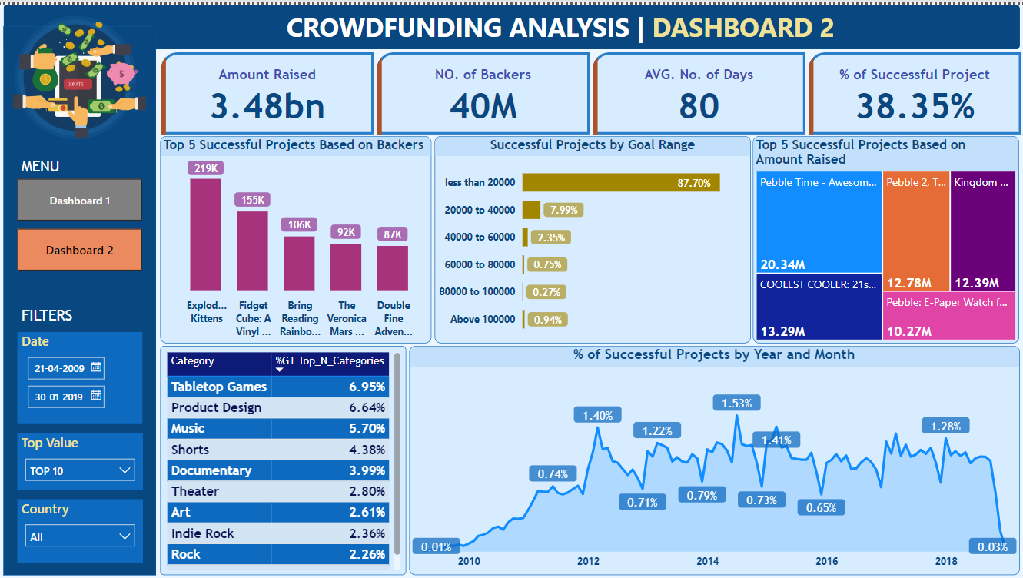
POWER-BI DASHBOARD

Slide 13

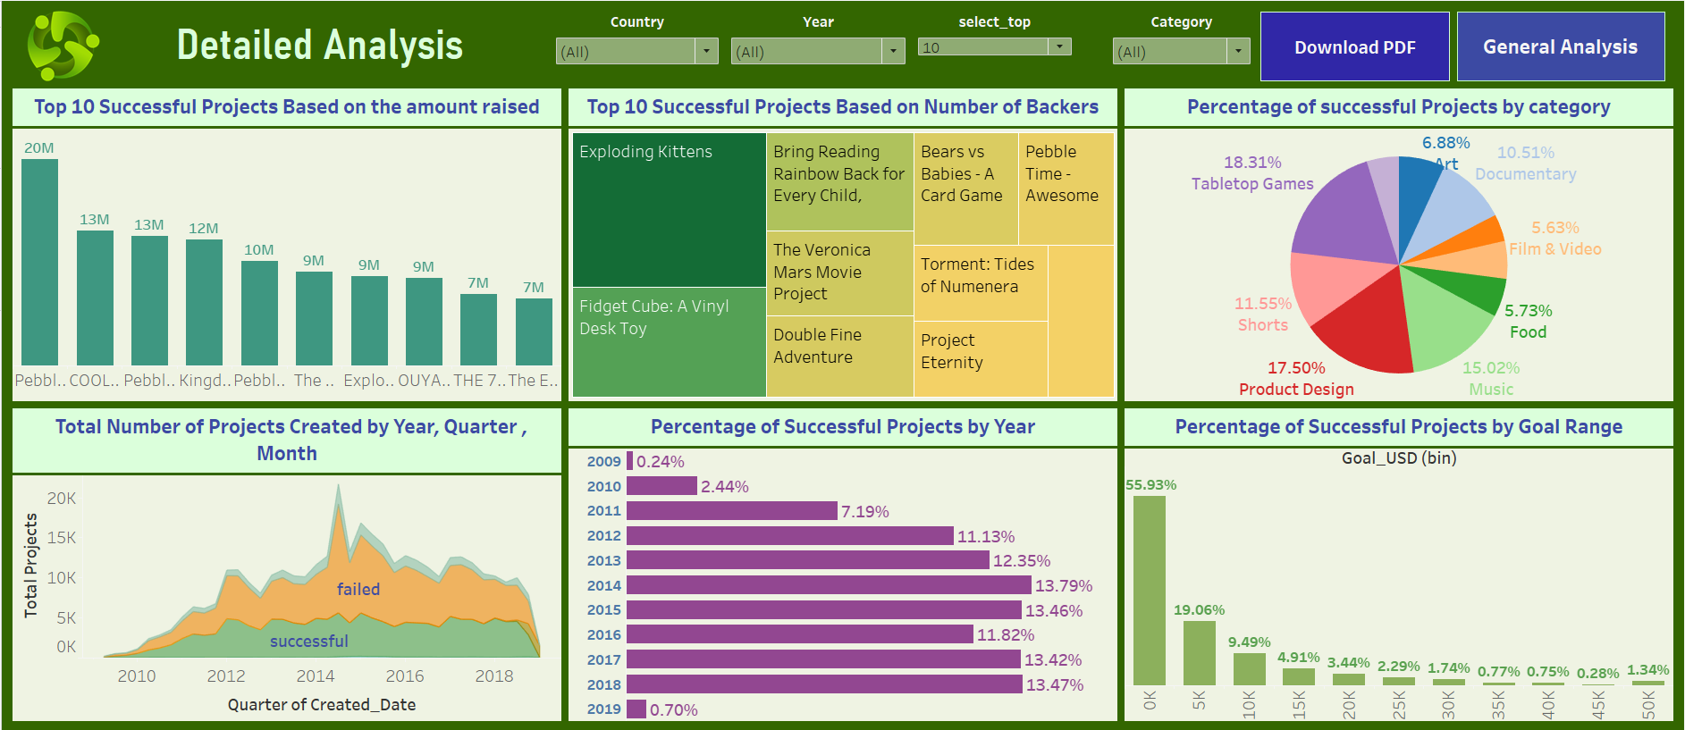
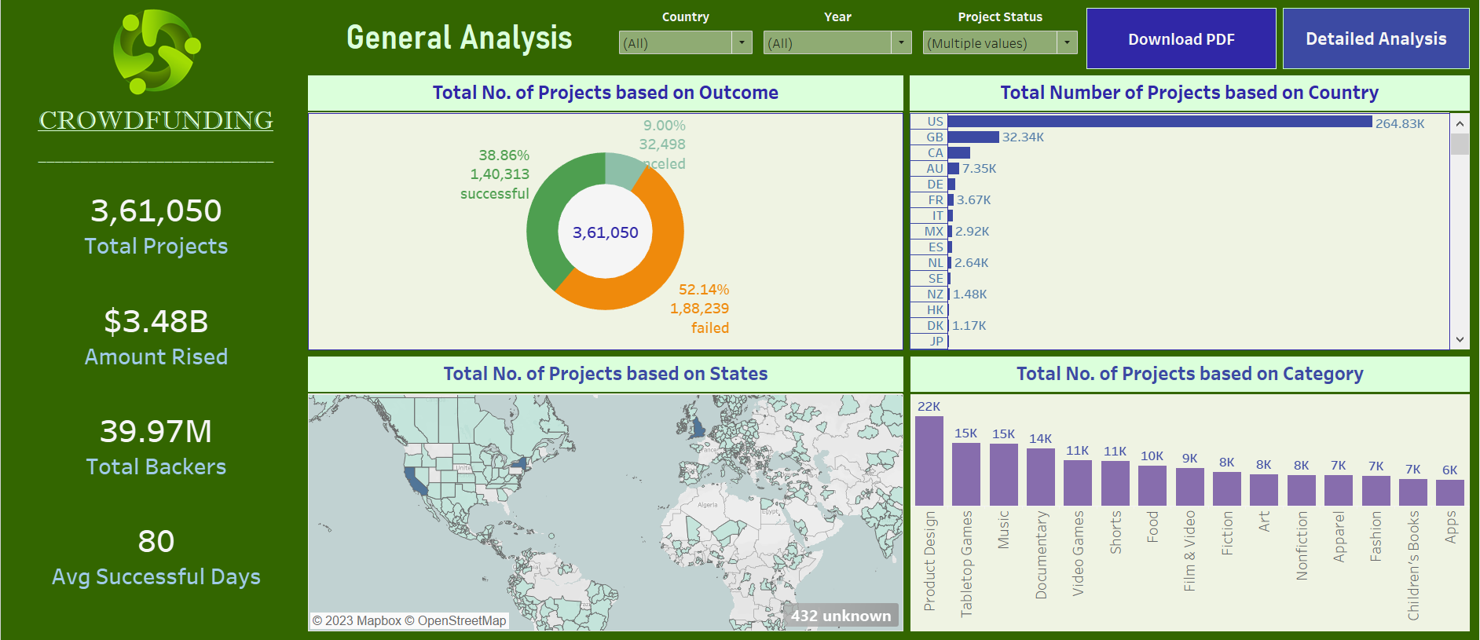
TABLEAU DASHBOARD

Slide 14

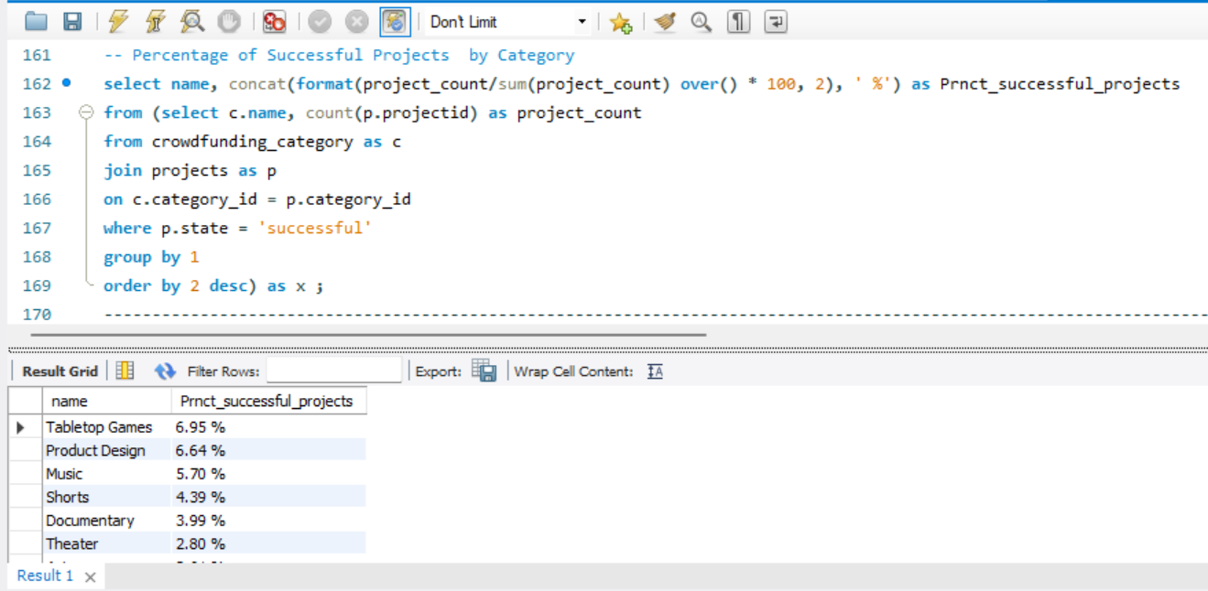
MySQL QUERY

Slide 15
05
Insights & Suggestions

Slide 16
KPI CARDS
Overall Projects
Successful Projects
366K
Total Projects
140K (38.35%)
Total Projects
$ 3.86B
Total Amt Raised
$ 3.48B (90.23%)
Total Amt Raised
45M
Total Backers
40M (89.77%)
Total Backers

Slide 17
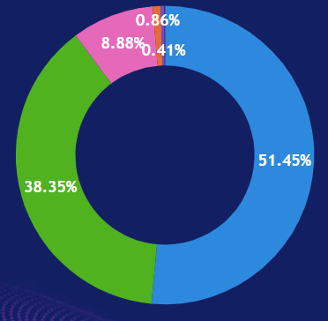
Projects based on Status
38%
Successful Projects
51%
Failed Projects
8.8%
Cancled
1.3%
Others

Slide 18
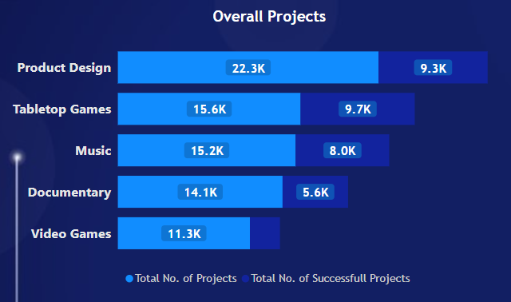
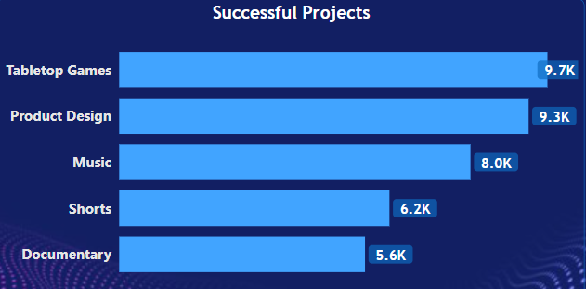
Top Projects by category
Overall Projects
We can see Product Design have majority of products followed by Tabletop Games and Music.
Also the percent of successful projects in respective field.
Successful Projects
Similar fields observed for successful projects. The majority of Backers are interested in these creative fields. The company can promote these projects in future.

Slide 19
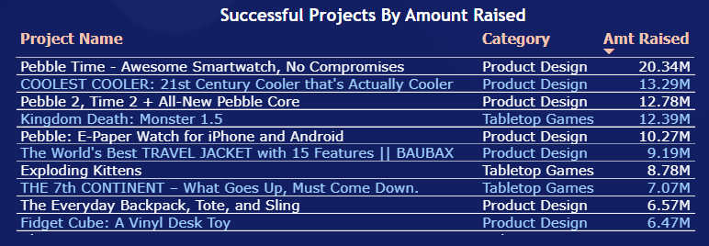
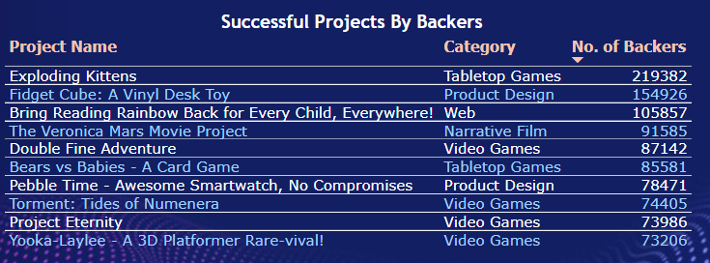
Successful Projects by
Amt Raised
The Pebble Time project raised the highest amount of funding in the Product Design category, while the majority of the other top projects were also belong to the Product Design and Tabletop Games, these categories similar to previous charts.
Successful Projects by Backers
In addition to categories Tabletop, Product Design other categories like Web, Narrative Film, Video Game have considerable amount of backers, implies stakeholders interest in these fields. These categories should be promoted.

Slide 20
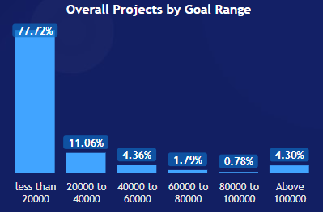
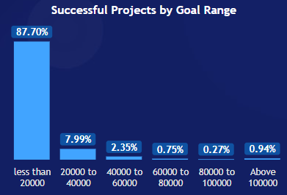
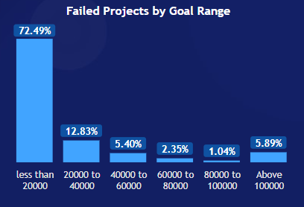
Goal Range analysis
Overall Projects
Successful Projects
Failed Projects
Around 78% Projects fall under Goal Range less than $20K.
87% projects fall under goal range less than $20K.
Projects belong Goal Range > $100K is 0.94%.
Category wise analysis help creators to set-up there goal amount.
72% failed projects also belong to less than 20k goal range. In upper range above $100K range ~6% projects falls. Higher amount projects generally fails.

Slide 21
Goal Amount Vs Received Amount
140.31K
Total Successful Projects
140.30K
136.5K
87.49K
Projects Received > Goal Amount
136.51K
43.52K
12.9K
Received > 10% Goal Amount
87.49K
Received > 50% Goal Amount
43.52K
Projects Received Double Goal Amount
12.9K

Slide 22
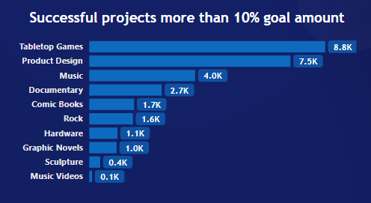
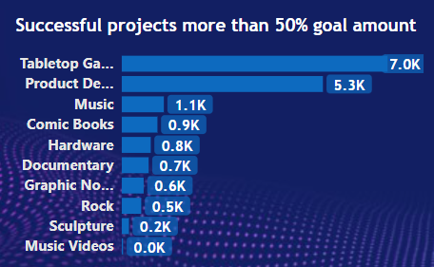
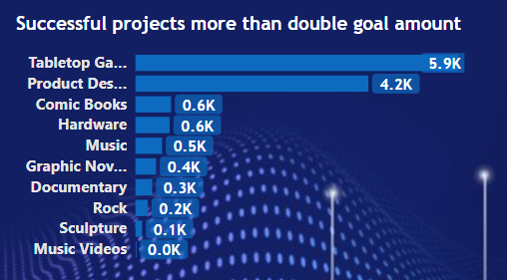
Received Amount analysis
In these charts we can see the categories in which backers pledged more than the goal amount, which indicates interest of people in these creative fields. So in addition to top Categories company can suggest creators the categories like Comic Books, Hardware, Rock, Graphic Novels, Sculpture, etc.

Slide 23
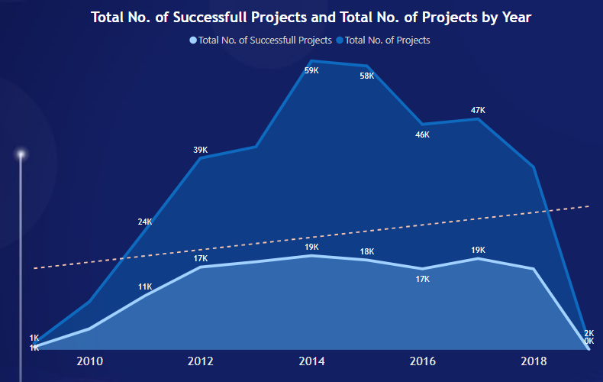
Year wise Analysis
Number of Projects increased in 2014 majorly but declined in later years.
On the other hand number of successful projects over the ten years not much affected.
We can see slightly upward trend.
For crowdfunding organization upward trend of successful projects matters a lot.

Slide 24
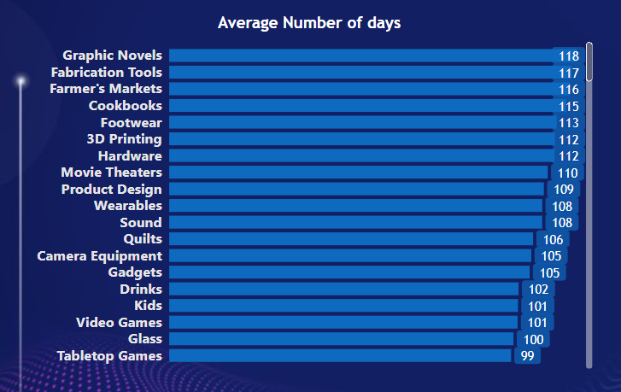
Day wise Analysis
80
Overall Avg. No. of Days
Here we can see category wise average number of days required for the project to be Successful. Providing this analysis to creators will helpful to set their deadlines accordingly.

Slide 25
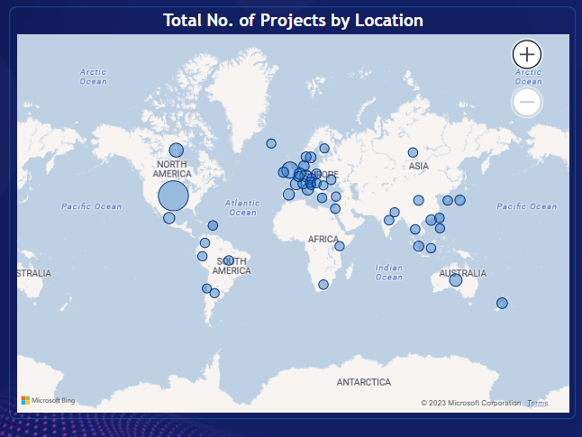
Location wise Analysis
From this chart, we can see the popularity of creating projects globally so that company can better target their markets. Here, the U.S. has the highest number of total projects followed by Great Britain and Canada. The company can invest more in these countries.

Slide 26
06
Conclusion

Slide 27
Kickstarter aims to make funding creative projects accessible to everyone. It allows anyone with a great idea to seek support directly from a global community of backers.
Kickstarter as a crowdfunding platform not directly engage in traditional business activities its success lies in the increasing number of backers and supporters. To achieve this, the organisation needs to enhance the trust and security among the stakeholders. This data analysis will help for the same.

Slide 28



Thank You

